Slide 1
L1 (CHAPTER 2) Data Representation Exercises
Acknowledgement: some slides taken from Yifeng Zhu’s courseware

Slide 2
Decimal, Binary and Hex
Review
Decimal | Binary | Hex
0 | 0000 | 0x0
1 | 0001 | 0x1
2 | 0010 | 0x2
3 | 0011 | 0x3
4 | 0100 | 0x4
5 | 0101 | 0x5
6 | 0110 | 0x6
7 | 0111 | 0x7
8 | 1000 | 0x8
9 | 1001 | 0x9
10 | 1010 | 0xA
11 | 1011 | 0xB
12 | 1100 | 0xC
13 | 1101 | 0xD
14 | 1110 | 0xE
15 | 1111 | 0xF
Prefix 0x denotes hex

Slide 3
Question: Number Conversion
Q: Convert 0x3A56E2F8 into binary
Q: Convert binary number 0011 1010 into hex
0x3A
Decimal | Binary | Hex
0 | 0000 | 0x0
1 | 0001 | 0x1
2 | 0010 | 0x2
3 | 0011 | 0x3
4 | 0100 | 0x4
5 | 0101 | 0x5
6 | 0110 | 0x6
7 | 0111 | 0x7
8 | 1000 | 0x8
9 | 1001 | 0x9
10 | 1010 | 0xA
11 | 1011 | 0xB
12 | 1100 | 0xC
13 | 1101 | 0xD
14 | 1110 | 0xE
15 | 1111 | 0xF

Slide 4
Adding two integers
Review
-9
+
6
9
flip
+1
-9
1 | 0 | 1 | 1 | 1
0 | 0 | 1 | 1 | 0
01001
10110
10111
23
6
Two’s Complement
Hardware Adder
29
flip
+1
3
1 | 1 | 1 | 0 | 1
00010
00011
Two’s Complement Counterpart
-3
Same bit patterns, different interpretation.
Unsigned addition: 23+6=29
Signed addition: -9+6=-3
This example shows that the hardware adder for adding unsigned numbers, also works correctly for adding signed numbers.
Notes:
{{Pause=1}} We will use a very simple example to show that, the hardware adder for adding unsigned numbers, also works correctly for adding signed numbers. {{Pause=0.5}}
Suppose we are adding negative nine and six. {{Pause=0.5}} These two signed numbers are represented in two’s complement in computers. {{Pause=0.5}}
Specifically, we can obtain the two’s complement representation of negative nine by flipping all bits and adding one. {{Pause=0.5}} The two’s complement of a positive number is itself. {{Pause=0.5}}
Let’s see what will happen if the hardware treats these two inputs as unsigned numbers. If these binary bits represent unsigned numbers, they are 23 and 6, respectively. Therefore, the hardware adds 23 and 6, and produces 29, in decimal, {{Pause=0.3}} or one, one, one, zero, one, in binary. {{Pause=0.5}}
If the output represents a signed integer in two’s complement, it actually represents negative 3. This can be proved by inverting all the bits and adding one. The result, negative three, is exactly the sum of the original signed inputs. {{Pause=0.5}}
This example shows that, without any modification, the hardware adder designed for adding unsigned numbers, works correctly for adding signed numbers.

Slide 5
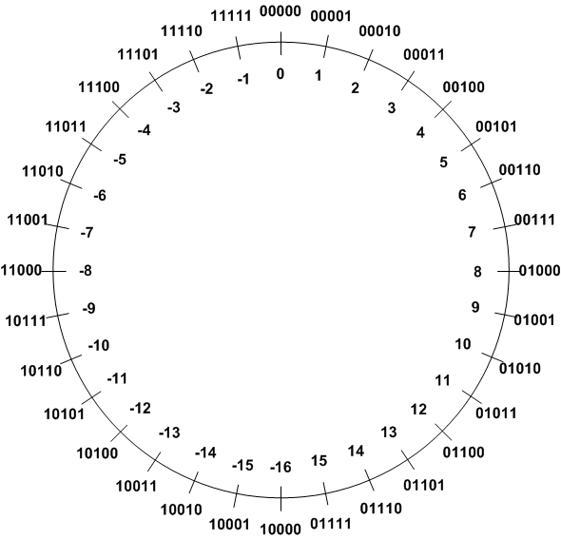

Signed Integers Method 3: Two’s Complement
Review
Two’s Complement ($\overline{α}$):
$$α+\overline{α}=2^{n}$$
TC of a number can be obtained by its bitwise NOT plus one.
Example 1: TC(3)
 | Binary | Decimal
Original number | 00011 | 3
Step 1: Invert every bit | 11100
Step 2: Add 1 | + 00001
Two’s complement | 11101 | -3

Slide 6

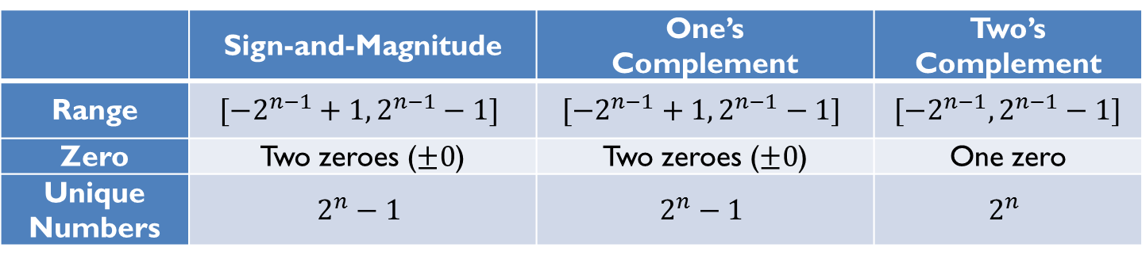
Signed Integer Representation Overview
Review
Three ways to represent signed binary integers:
Signed magnitude
$value={(−1)}^{sign}×Magnitude$
One’s complement ($\tilde{α}$)
$α+\tilde{α}=2^{n}−1$
Two’s complement ($\overline{α}$)
$α+\overline{α}=2^{n}$
 | Sign-and-Magnitude | One’s Complement | Two’s Complement
Range | $$[−2^{n−1}+1, 2^{n−1}−1]$$ | $$[−2^{n−1}+1, 2^{n−1}−1]$$ | $$[−2^{n−1}, 2^{n−1}−1]$$
Zero | Two zeroes ($±0$) | Two zeroes ($±0$) | One zero
Unique Numbers | $$2^{n}−1$$ | $$2^{n}−1$$ | $$2^{n}$$

Slide 7
Question: 2’s Complement
For each of the following binary numbers in a 8-bit system, give the corresponding binary number of the negative of its value, for 2’s-complement system
(a) x=01010101
TC(x)=10101011
(b) x=10101010
TC(x)=01010110
(c) x=10000000
TC(x)=10000000

Slide 8
Question: Number Conversion
Q: What is the decimal value of binary number x=10100111 as either unsigned int, or signed int in 2’s complement representation?
Unsigned int: 2^7+2^5+2^2+2^1+2^0= 167
Signed int: 10100111=-89 flip 01011000 add 1 01011001=89
01011001 flip 10100110 add1 10100111
What about x=11100001?
Unsigned int: 225 = 2^7+2^6+2^5+2^0=
Signed int: 00011110 + 1 = 00011111 = 31 so 11100001 = -31
What about x=10000000?
Unsigned int: 128
Signed int:-128

Slide 9
Question: Number Conversion
Q: Which number is larger: 1001 or 0011 in binary?
If unsigned int: 1001
If signed int: 1001=-7 0011=3
0111 = 7
Q: Which number is larger: 0xFFFFFFFF or 0x00000001 in hex?
If unsigned int: 0xFFFFFFFF=2^32 – 1 0x00000001=1
If signed int: 0xFFFFFFFF= 111111111111111111111 =-1
invert: 0x00000000 add1: 0x00000001
0x00000001=1

Slide 10
Question: Number Range
Which range of decimals can be expressed with a 6-bit signed number (assuming Two’s complement representation)?
Answer | Range
A | -32 … 32
B | -64 … 63
C | -31 … 32
D | -16 … 15
E | -32 … 31

Slide 11
Question: Number Range
Which range of decimals can be expressed with a 6-bit unsigned integer?
Answer | Range
A | -32 … 32
B | -64 … 63
C | -31 … 32
D | -16 … 15
E | -32 … 31

Slide 12
Question: Integer arithmetic
Q: Consider a 4-bit system. What is the result of 1001 + 0011?
1001 + 0011 = 1100
Unsigned: 9+3=12
Signed:-7+3=-4

Slide 13
Summary of Carry and Overflow Flags
Review
Bit | Name | Meaning after add or sub
N | negative | result is negative
Z | zero | result is zero
V | overflow | signed overflow
C | carry | unsigned overflow
Carry flag C = 1 upon an unsigned addition if the answer is wrong (true result > 2^{n}-1)
Carry flag C = 0 (Borrow flag = 1) upon an unsigned subtraction if the answer is wrong (true result < 0)
Overflow flag V =1 upon a signed addition if the answer is wrong (true result > 2^{n-1}-1 or true result < -2^{n-1})
31
0
N
Z
C
V
13
CPSR (Current Program Status Register)
Notes:
C is cleared upon an unsigned subtract if the answer is wrong

Slide 14
Signed or unsigned
Review
Whether the carry flag or the overflow flag should be used depends on the programmer’s intention.
uint a;
uint b;
…
c = a + b
…
int a;
int b;
…
c = a + b
…
C Program
C Program
Check the carry flag
for unsigned addition
Check the overflow flag
for signed addition

Slide 15
Question: Addition
Q: Consider a 4-bit system. What is the result of addition 1011+0110, assuming either unsigned integers, or signed integers in 2’s-complement representation？
Unsigned: 8+2+1=11 11+6=17, result 0001 = 1, Carry=1
Signed: 1011=-5 -5+6=1, result 0001 = 1, overflow=0
1011
0110
10001

Slide 16
Question: Subtraction
Q: Q: Consider a 4-bit system. What is the result of subtraction 1011-0110, assuming either unsigned integers, or signed integers in 2’s-complement representation？
Unsigned: 11-6=5
Signed: -5-6=-11 0101=5, overflow=1
1011
-0110
=0101

Slide 17
Question: Subtraction
Q: Consider a 4-bit system. What is the result of subtraction 0110-1011, assuming either unsigned integers, or signed integers in 2’s-complement representation？
Unsigned int: 6-11=11 carry=0 borrow=1
Signed int 6-(-5)=-5 overflow=1
0110-1011=1011

Slide 18
Question: True or False
1. Borrow is impossible when subtracting one unsigned number from another.
2. Overflow is impossible when subtracting two signed operands of the same sign.
3. There are two representations of zero in 2’s complement representation.
4. In 2’s complement, the absolute values of full-scale negative and full-scale positive are identical

